Slide 1


School Logo
ATM BANKING SYSTEM
TEAM MEMBERS
HARIHARAN.M
ARAVINTH.M
MADHAN.G

Slide 2
Aim:
School Logo
To create an application which simulates the process of Automated Teller Machine (ATM) which includes the functions such as
To Check The Balance
Cash Withdrawal
Cash Deposit
To Change The PIN
To Exit The Process

Slide 3
Graphical Representation or Flow Chart
School Logo
User ID
Enter PIN
Yes
2nd try,3rd try
No
Valid Pin
No
Yes
To Check The Balance
Cash Withdrawal
Cash
Deposit
Change PIN
Return Card
Yes
To Continue
No
End

Slide 4
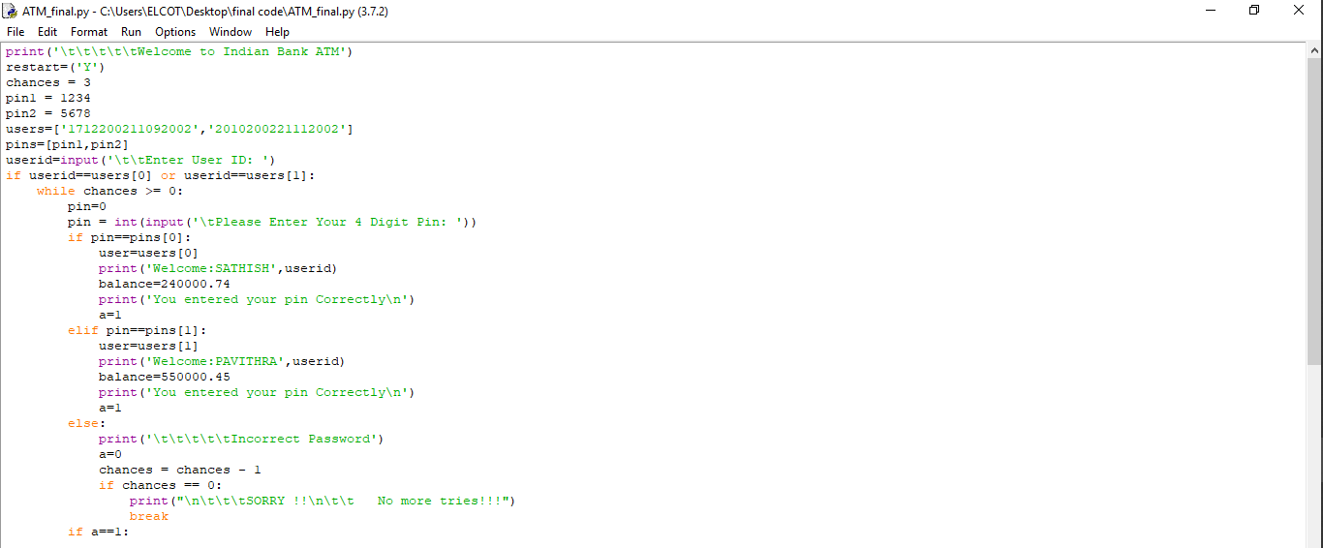
Source Code:
School Logo
print('\t\t\t\t\tWelcome to Indian Bank ATM')
restart=('Y')
chances = 3
pin1 = 1234
pin2 = 5678
users=['1712200211092002','2010200221112002']
pins=[pin1,pin2]
userid=input('\t\tEnter User ID: ')
if userid==users[0] or userid==users[1]:
while chances >= 0:
pin=0
pin = int(input('\tPlease Enter Your 4 Digit Pin: '))
if pin==pins[0]:
user=users[0]
print('Welcome:SATHISH',userid)
balance=240000.74
print('You entered your pin Correctly\n')
a=1
elif pin==pins[1]:
user=users[1]
print('Welcome:PAVITHRA',userid)
balance=550000.45
print('You entered your pin Correctly\n')

Slide 5
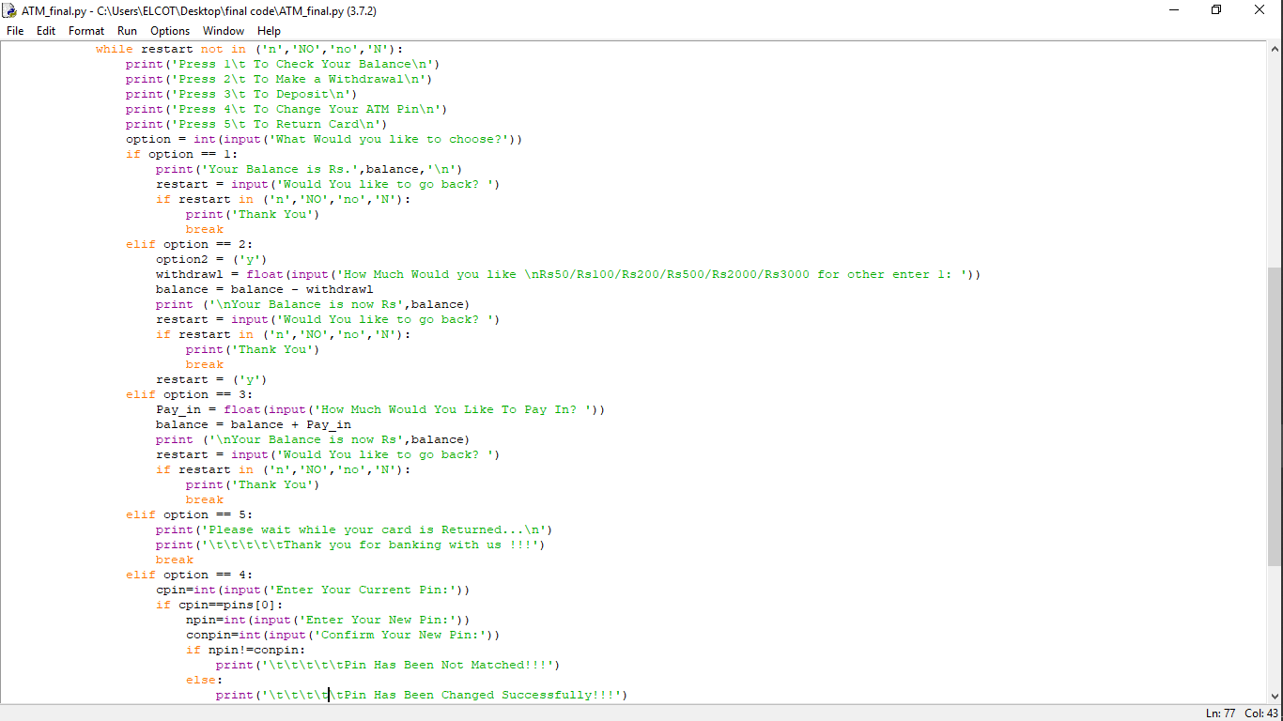
a=1
else:
print('\t\t\t\t\tIncorrect Password')
a=0
chances = chances - 1
if chances == 0:
print("\n\t\t\tSORRY !!\n\t\t No more tries!!!")
break

Slide 6
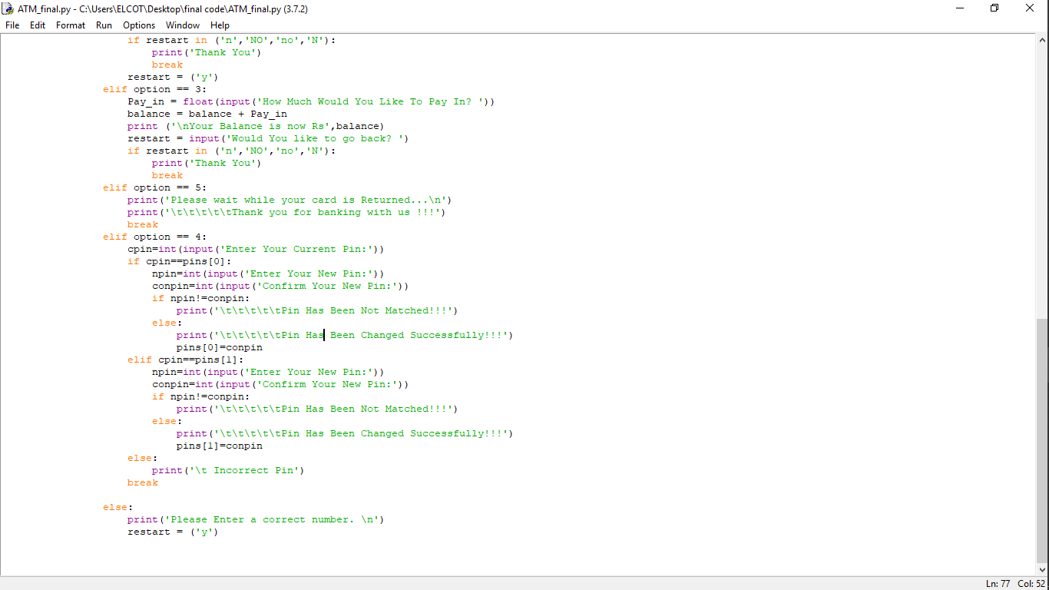

Slide 7
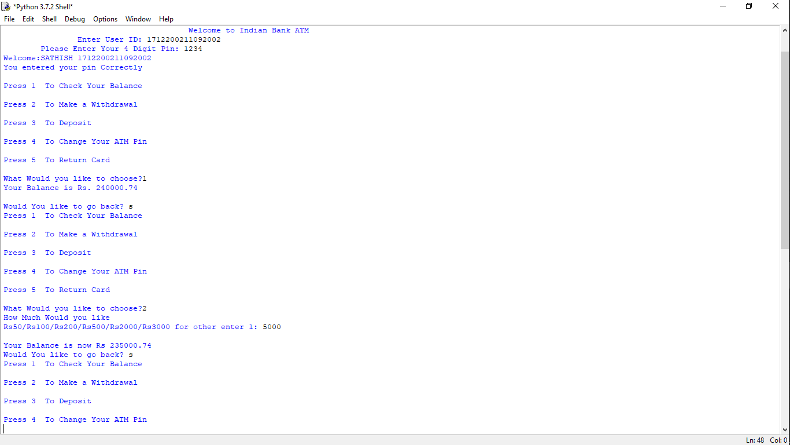
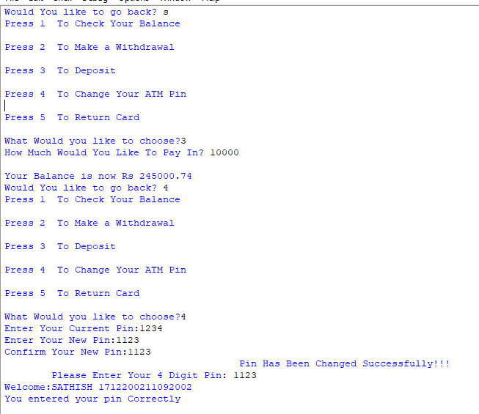
Inputs And Outputs
School Logo

Slide 8
Application:
School Logo
Automated Teller Machine(ATM) is used to
To check the balance
To withdraw cash
To deposit cash
To change the pin
From any where without going to the bank.

Slide 9
Conclusion:
School Logo
This application simulates the process of Automated Teller Machine (ATM) which will be helpful in understanding the operations in Automated Teller Machine.

Slide 10
Thank You
School Logo

